Slide 1
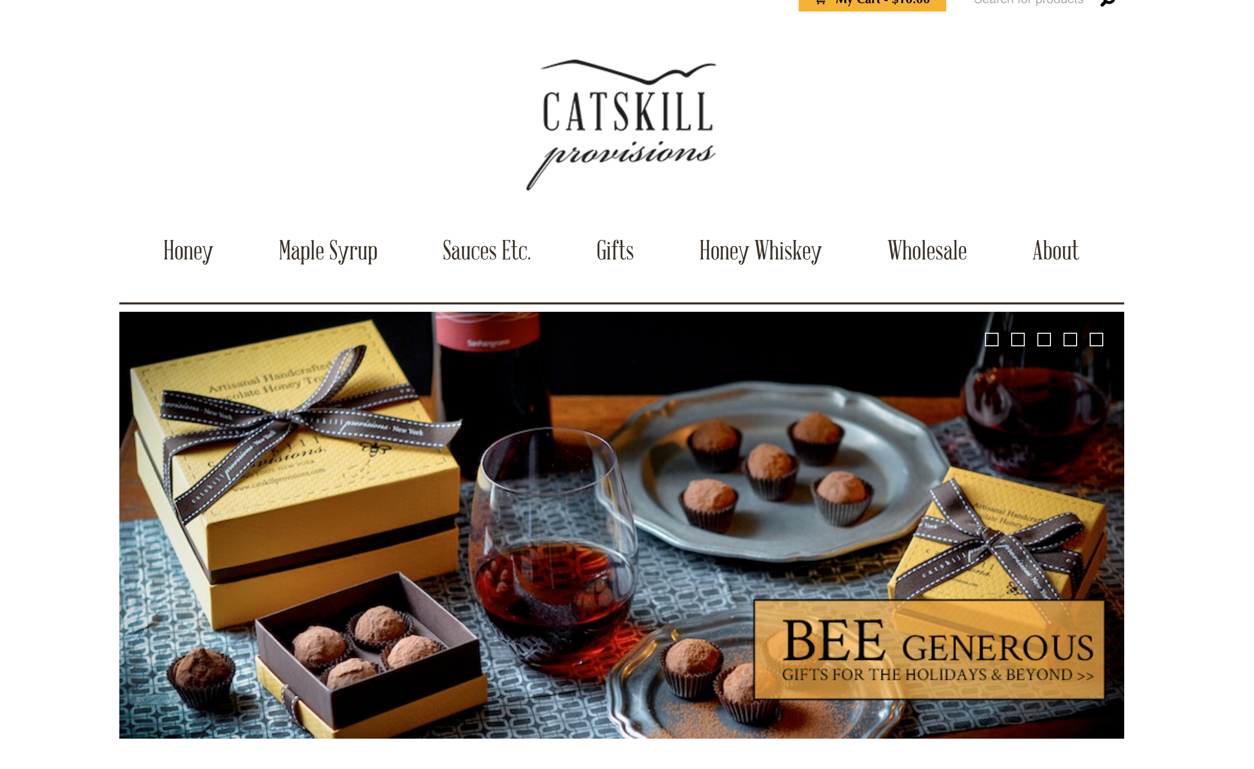
Business Case: Scaling CatskillProvisions.com

Slide 2

BACKGROUND
Small ecommerce website with growth intentions
Originated in 2010 out of a passion for bee keeping
First product sold online was honey
Honey continues to be the primary product sold along with other gift items
This analysis is the first time anyone has looked at the backend of the website: customers/traffic/sales conversion

Slide 3
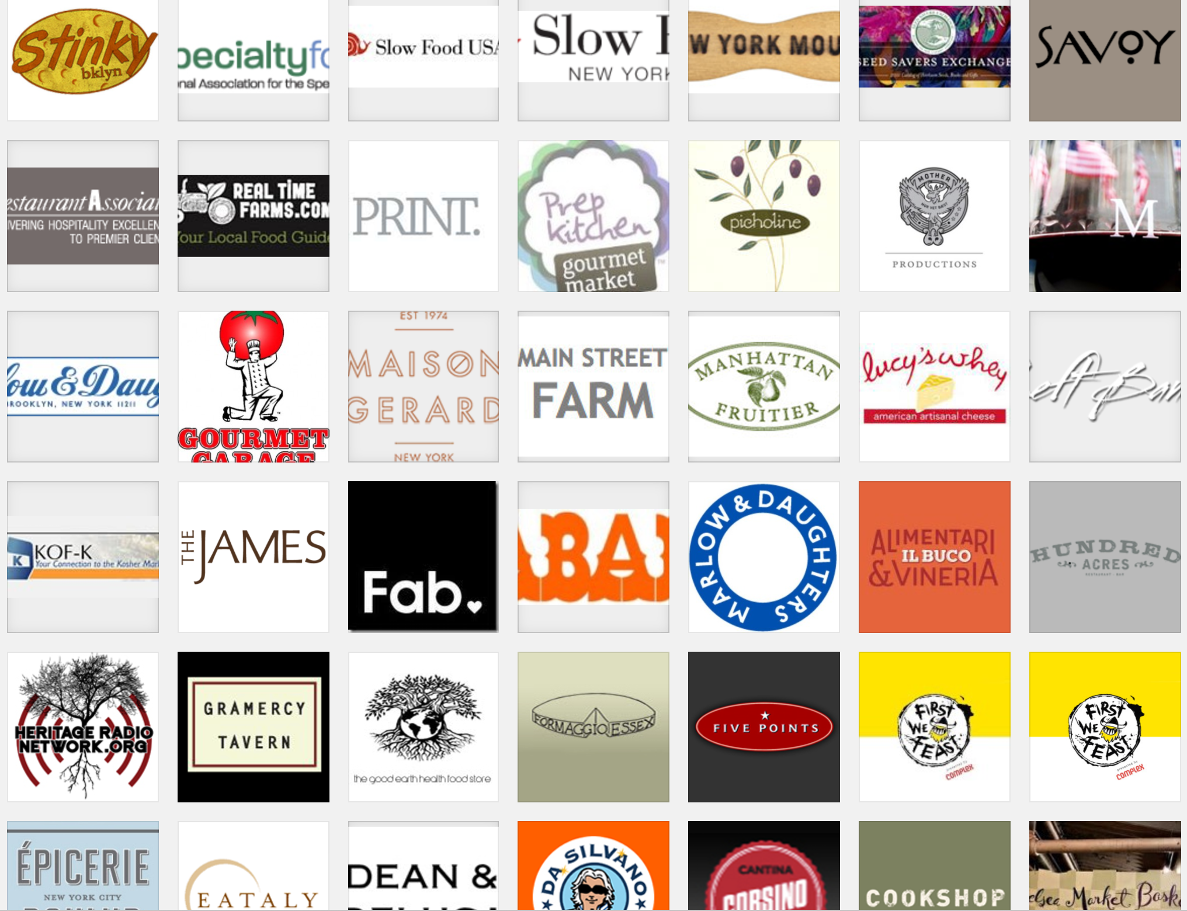
TALE OF TWO BUSINESSES
Two parallel businesses for Catskill Provisions
Primary: selling products (honey, whiskey) wholesale to restaurants, liquor stores, specialty shops
Secondary: ecommerce website
OPPORTUNITY: pursue ecommerce website given interest to scale web traffic, converting traffic to sales and delivering revenue improvement

Slide 4
EDA: WEB ECOMMERCE CUSTOMER PROFILE
Female (76%)
Region: East (NY, NJ), New England (67%)
1x purchaser (85%)
Tuesday/Thursday web shopper (shopping from work)
Most purchased products: Honey, Truffles, Gift Sets
Product associations: Honey wands with Honey; Maple Syrup with Honey (Apriori algorithm)
Email Domain: Gmail; Yahoo; AOL; work domain

Slide 5
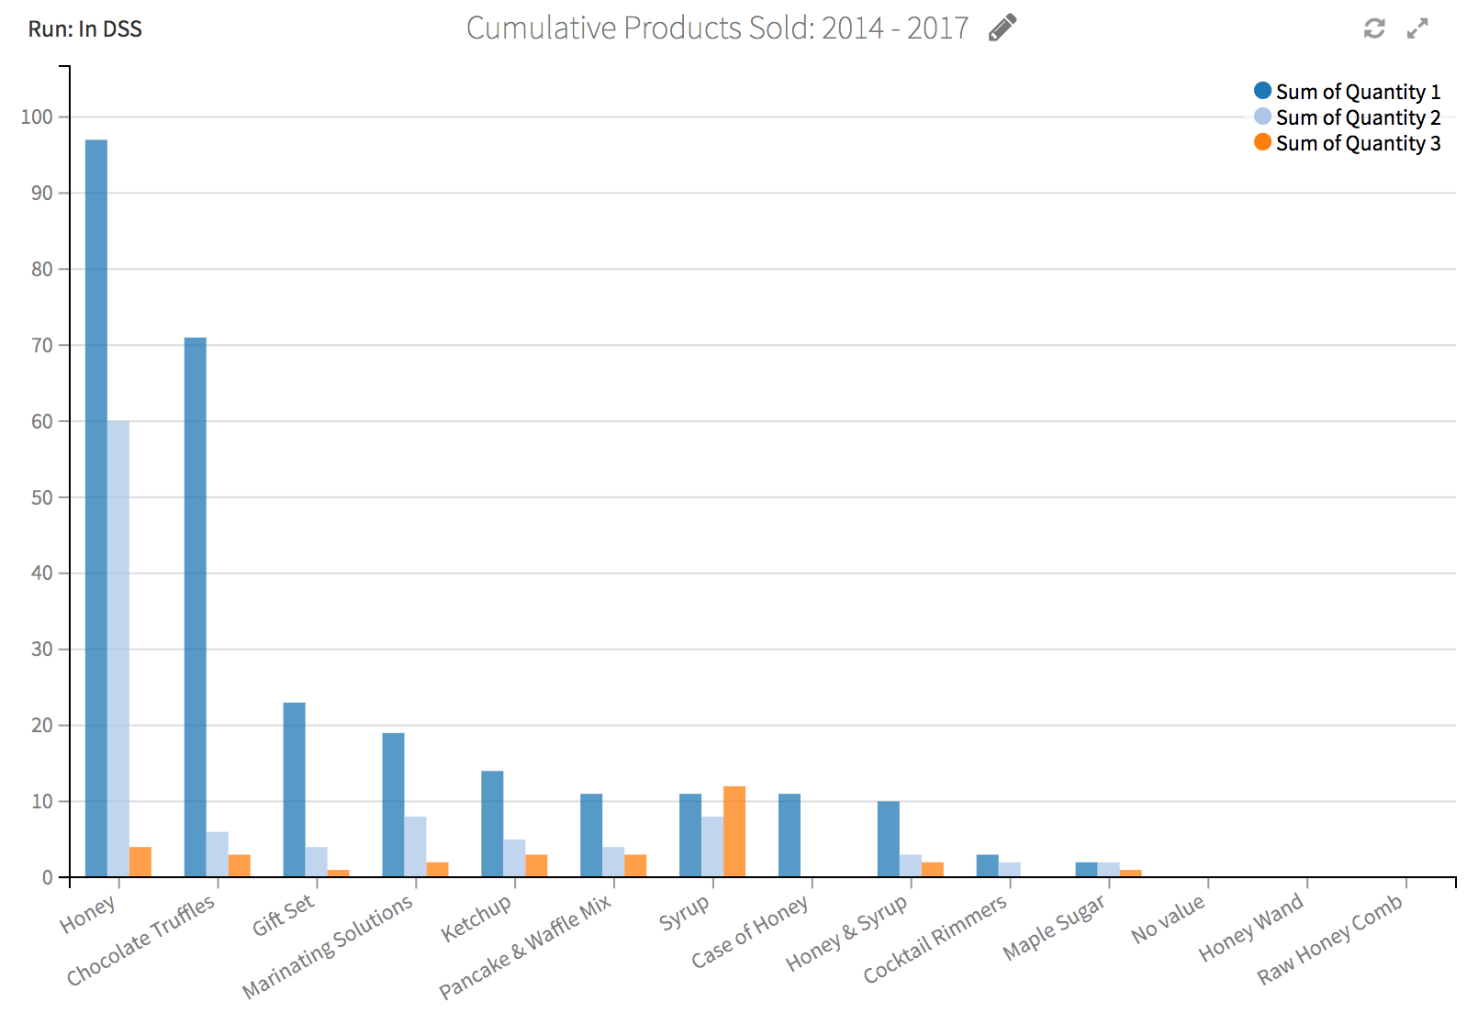
EDA: WEB STORE PRODUCTS

Slide 6
EDA: BUSINESS SNAPSHOT
Year | Customers | Avg Sales | Repeat Customer % Total Sales | Visits Conversion | Unique Visits Conversion
1Q2017 | 91 | $22.52 | 30.7% | 1.56% | 2.17%
FY2016 | 312 | $40.10 | 26.3% | 1.03% | 0.79%
FY2015 | 320 | $37.50 | 16.7% | 0.90% | 0.77%
FY2014 | 125 | $54.86 | 6.6% | 0.70% | 0.39%

Slide 7
EDA: WEB TRAFFIC CHANGES 2015 – YTD
Year | Unique Visitors % Chg | No. of Visitors % Chg | Page Views % Chg | Site Hits % Chg
1Q2017 | -53.7% | -59.2% | -59.0% | -49.5%
FY2016 | -5.3% | -7.7% | -8.8% | -11.7%
FY2015 | 29.2% | 32.9% | 79.1% | 30.9%

Slide 8
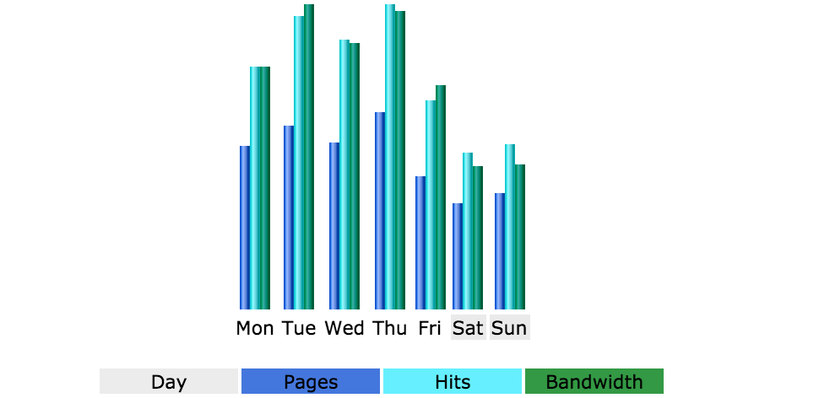
EDA: PURCHASE BEHAVIOR – DAY OF WEEK

Slide 9
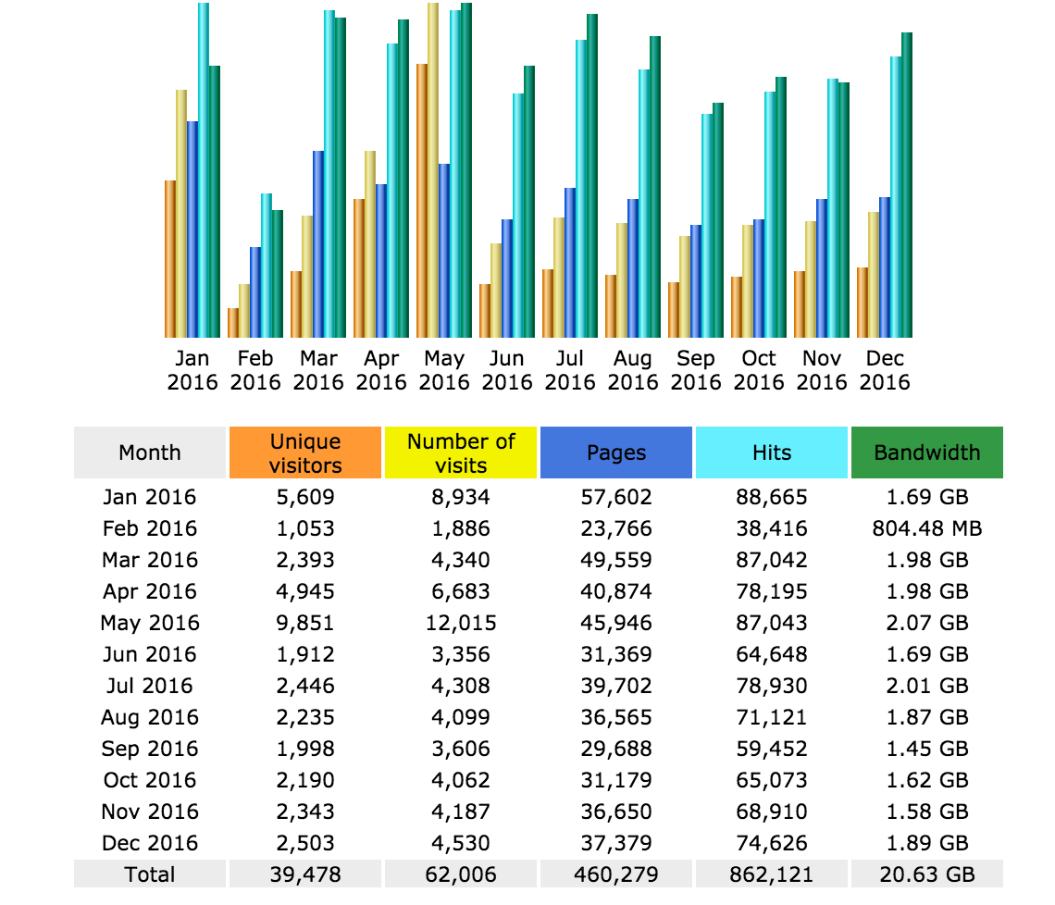
EDA: PURCHASE BEHAVIOR – TIME OF YEAR

Slide 10
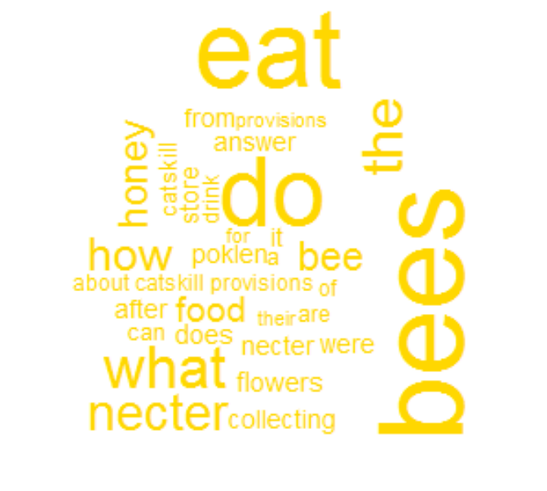
EDA: SEO WORDCLOUD – GOOGLE PRIMARY REFERER

Slide 11
EDA: TOP SEARCH PHRASES
do bees eat nectar
what do bees eat
were do the bees store the necter after collecting it from the flowers answer
how bees eat poklen
are bees can eat nectar
about catskill provisions
what do bees eat for food
what is the food of honey bees
what do bees do with nectar
searching of food in honey bee
how do bee s eat
how does a bee feed her babies
what do bumble bees eat and drink
how do bees eat

Slide 12
DATA SET VARIABLES
Small website, small data set – trained
Combination of transactional and web traffic data
Each row represents transactional data
Key variables in data set
Transaction date/day of the week
Shipping & Billing State & Region
Repeat Purchases
Email domain
Daily Web Visits/Web Hits
Purchase Total
Total Order Quantity
Product for Sale
Sales
Sales to Web Visit Conversions

Slide 13
DATA SET VARIABLES
Certain features highly correlated
Clustering and PCA not useful
Modeled Features:
Shipping Region
Repeat Purchasers
Gender
Other Features Modeled:
Total Purchase Quantity
Email Domain
Web Visits
Sales

Slide 14
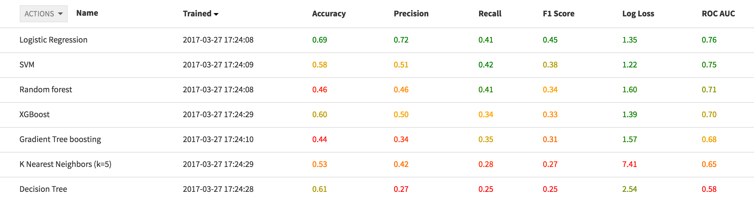
SHIPPING REGION: MODEL OUTPUT

Slide 15
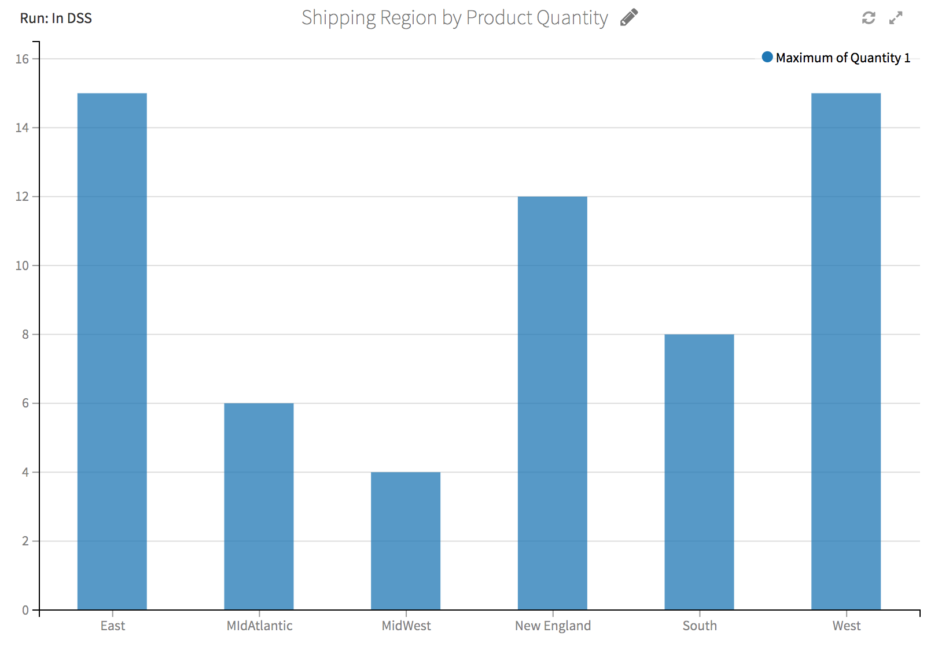
SHIPPING REGION BY PRODUCT QUANTITY

Slide 16
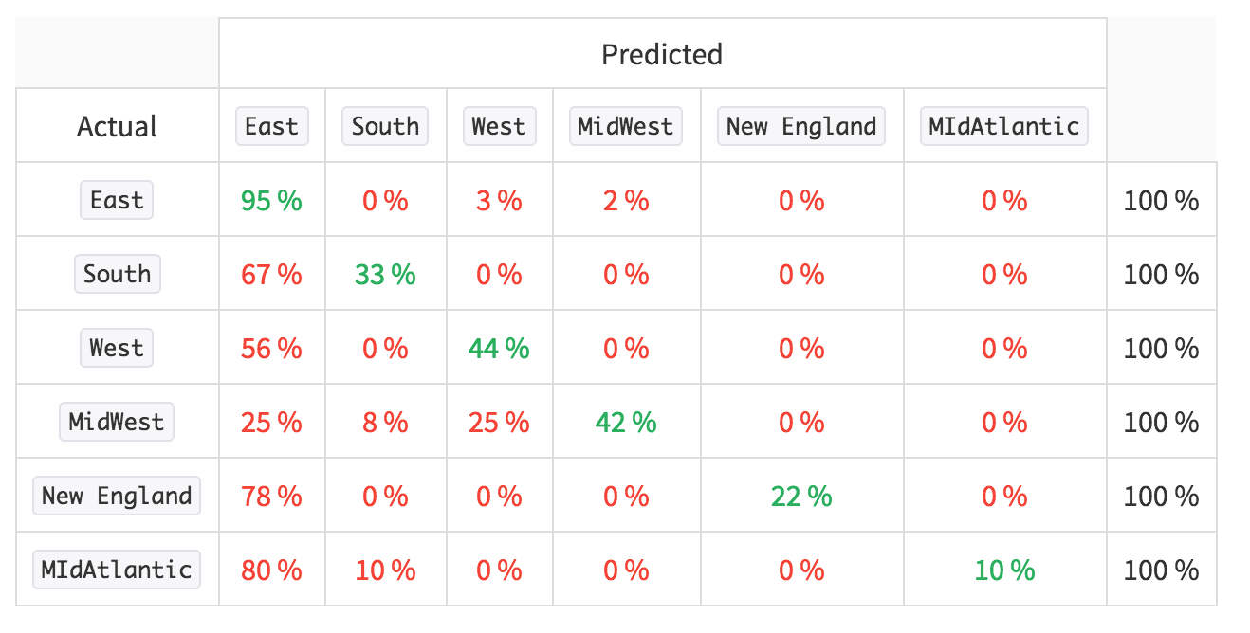
SHIPPING REGION: CONFUSION MATRIX

Slide 17
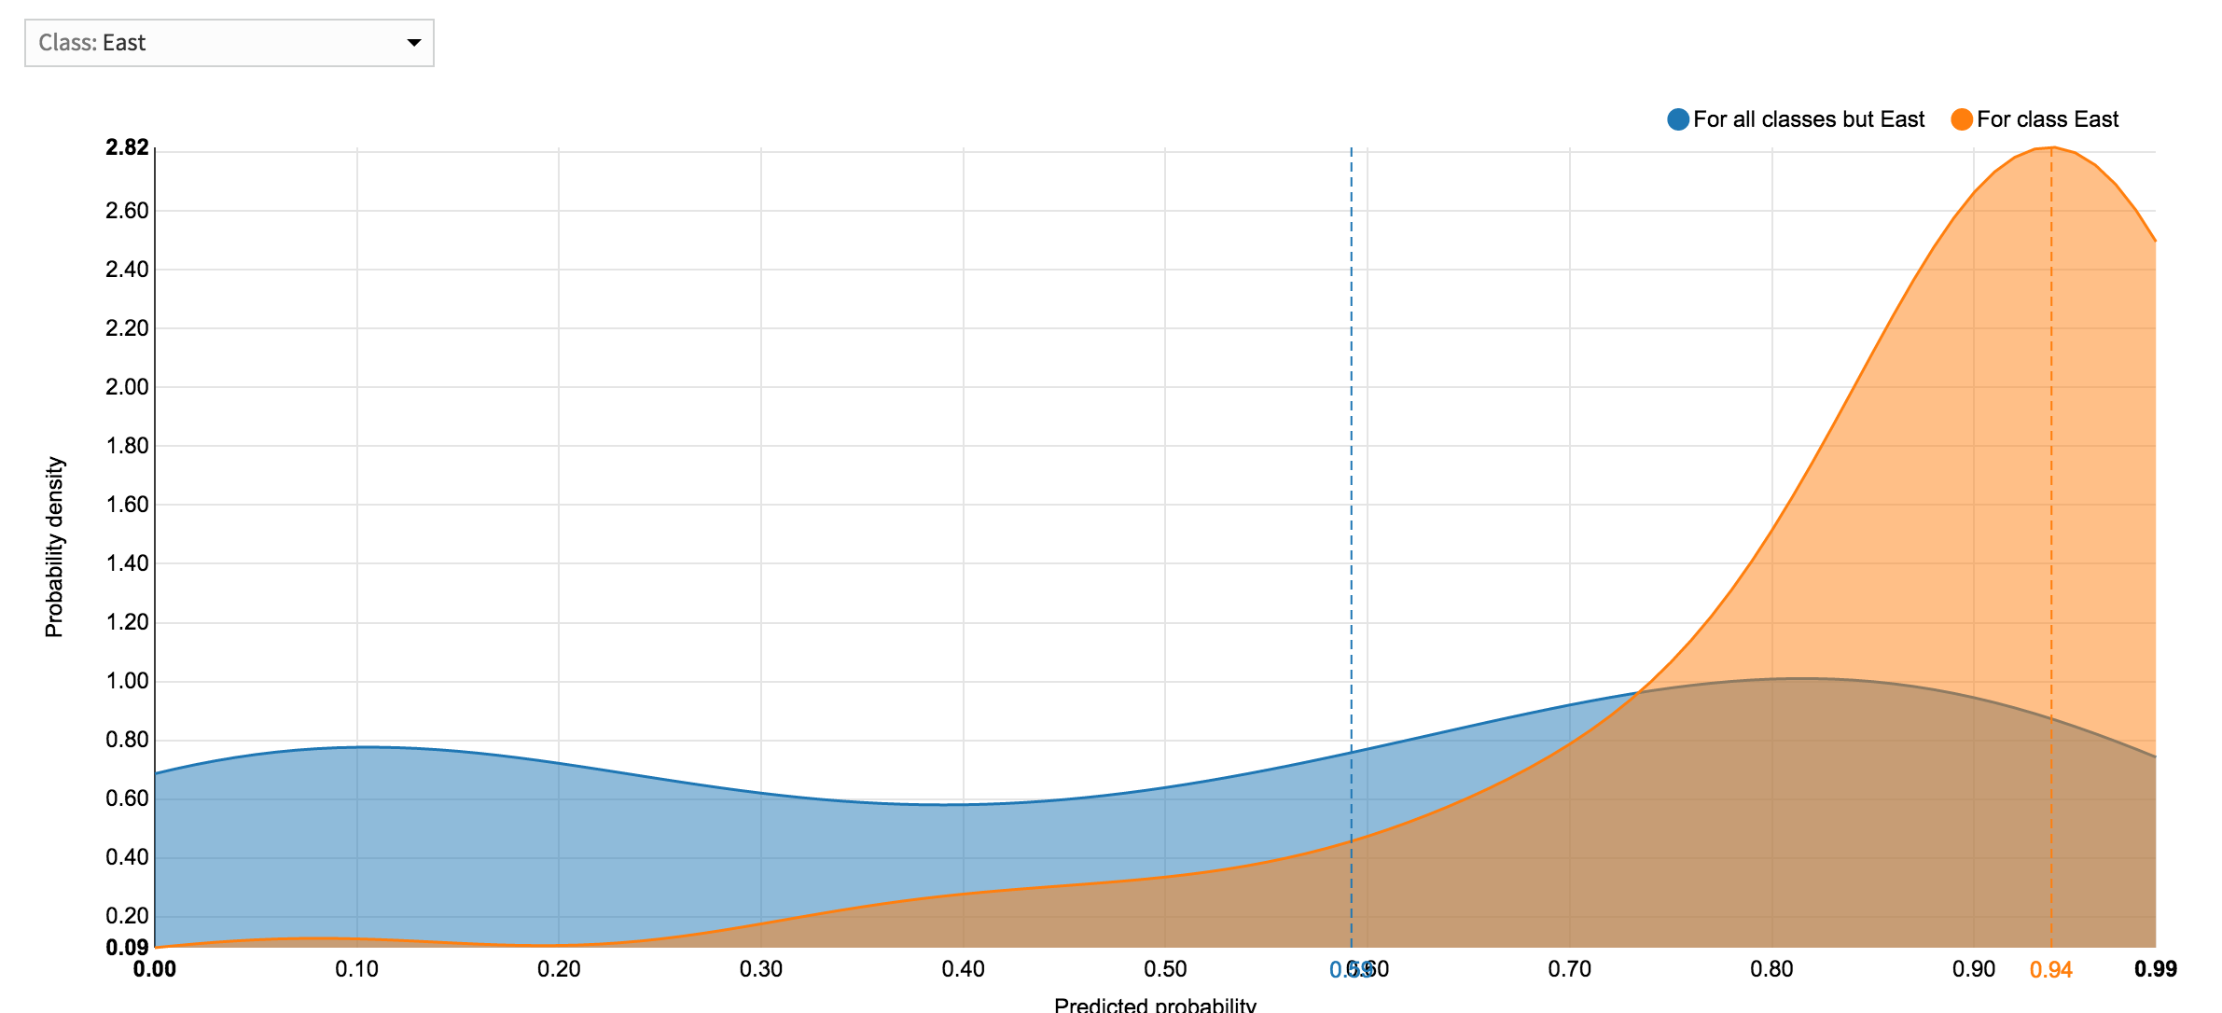
SHIPPING REGION: LOGISTIC DENSITY CURVE

Slide 18
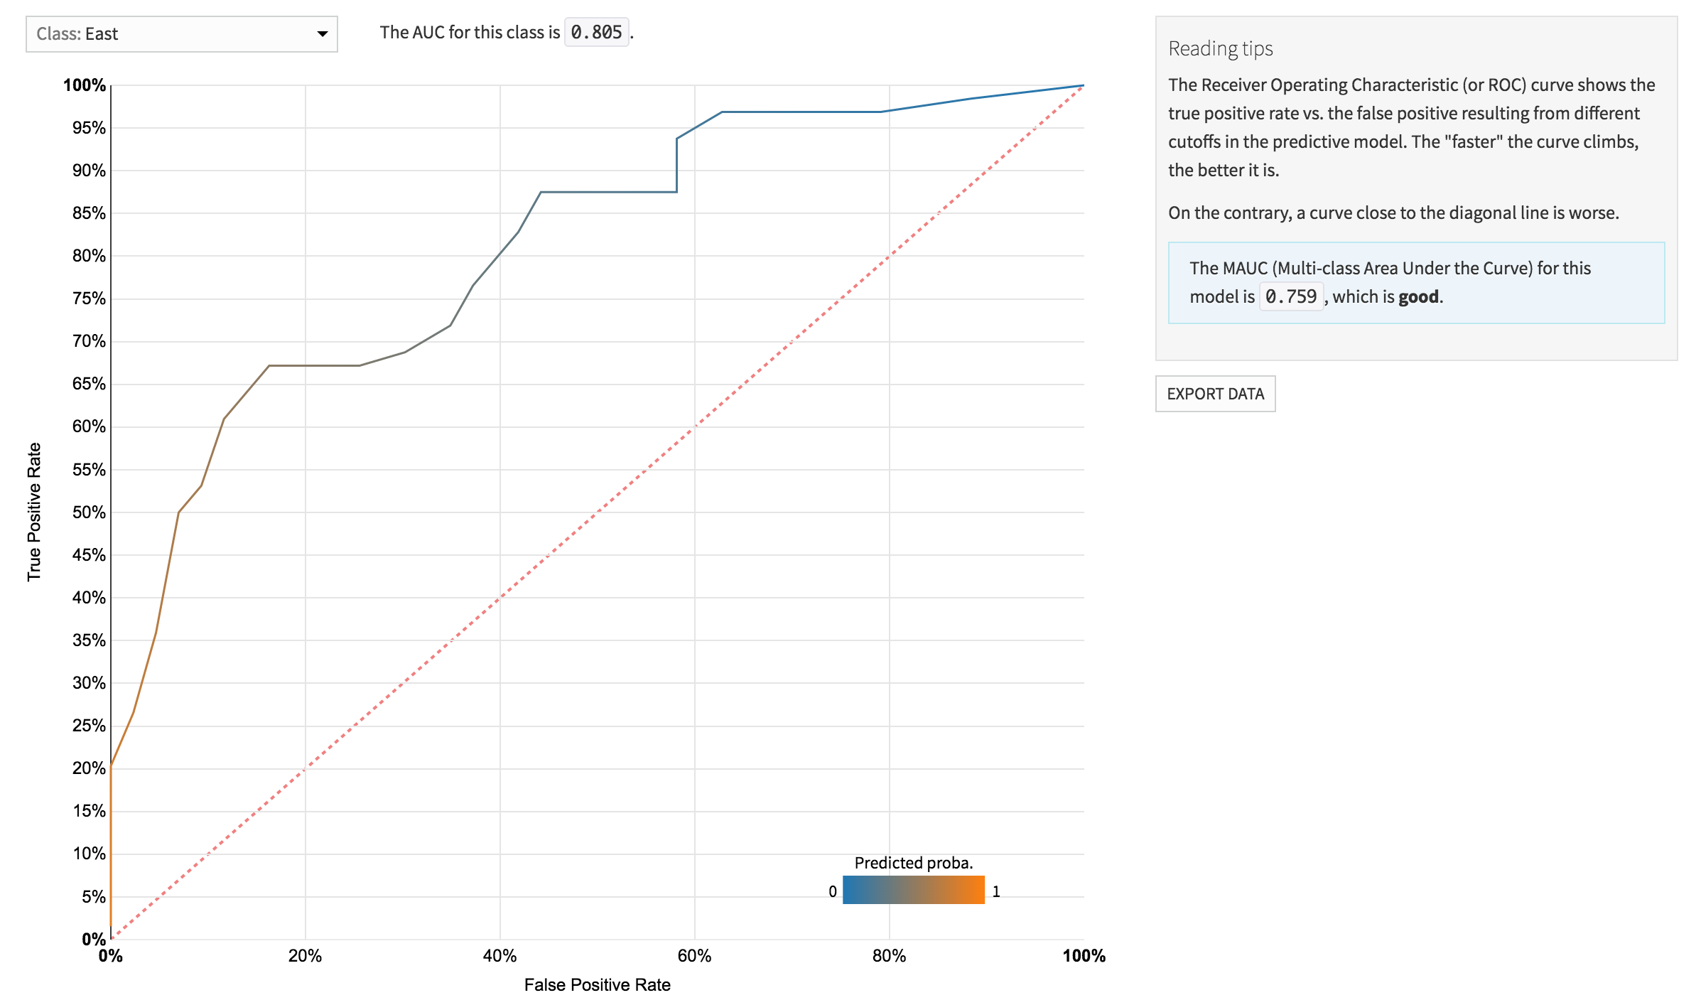
SHIPPING REGION: LOGISTIC ROC AUC

Slide 19
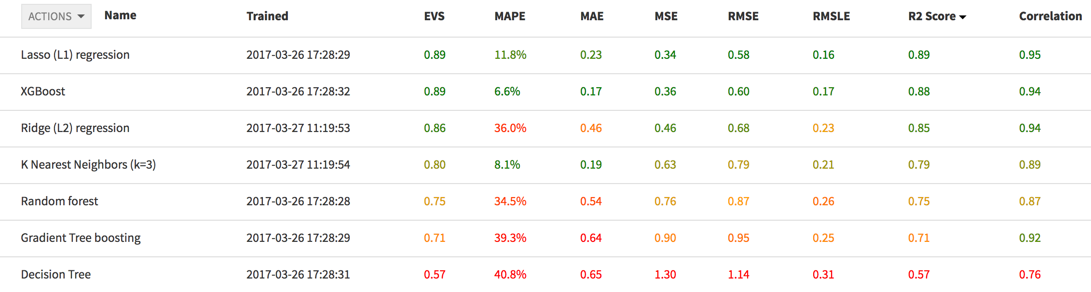
REPEAT PURCHASES: MODEL OUTPUT

Slide 20
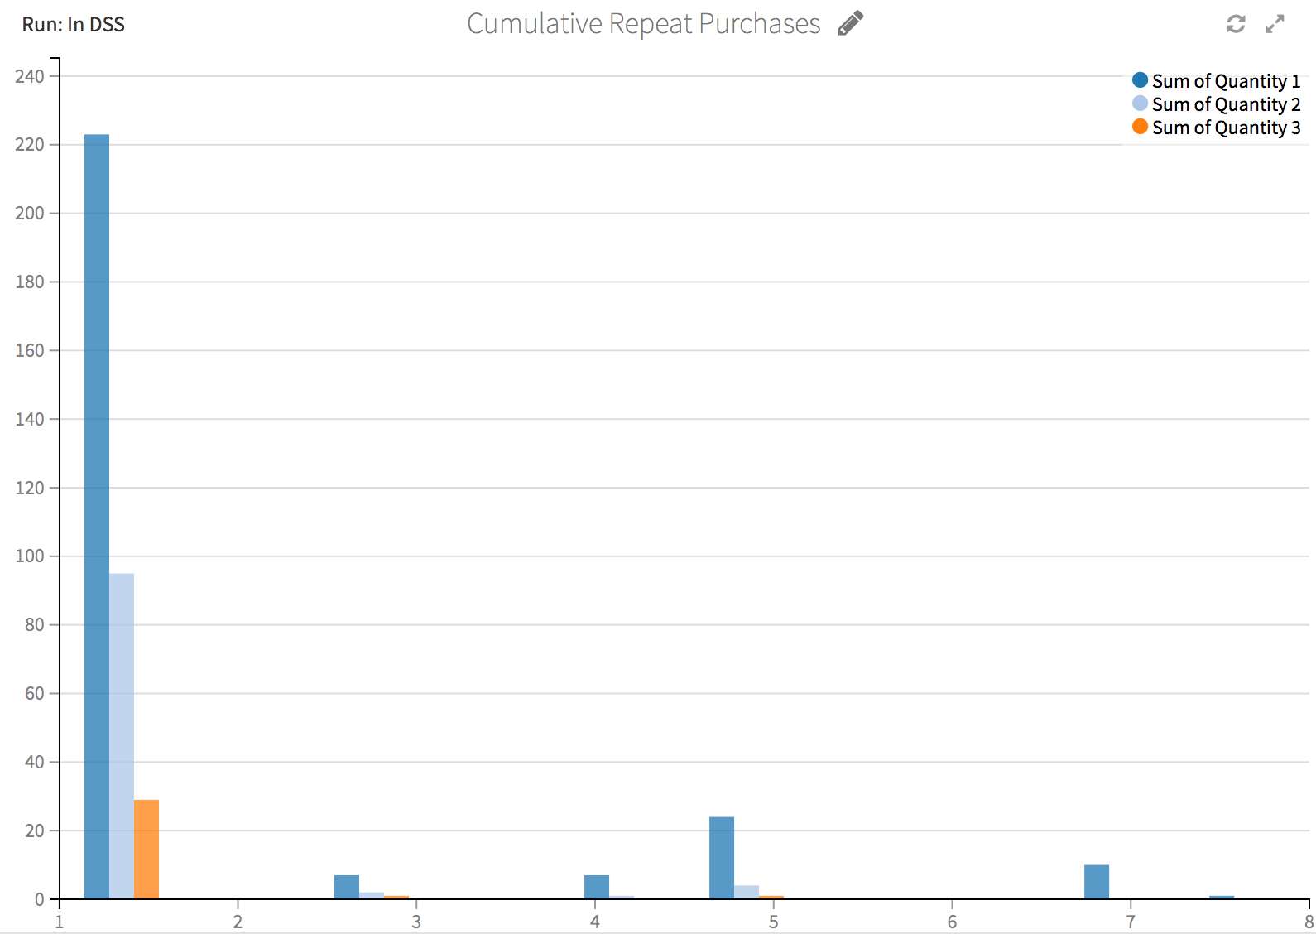
CUMULATIVE REPEAT PURCHASES

Slide 21
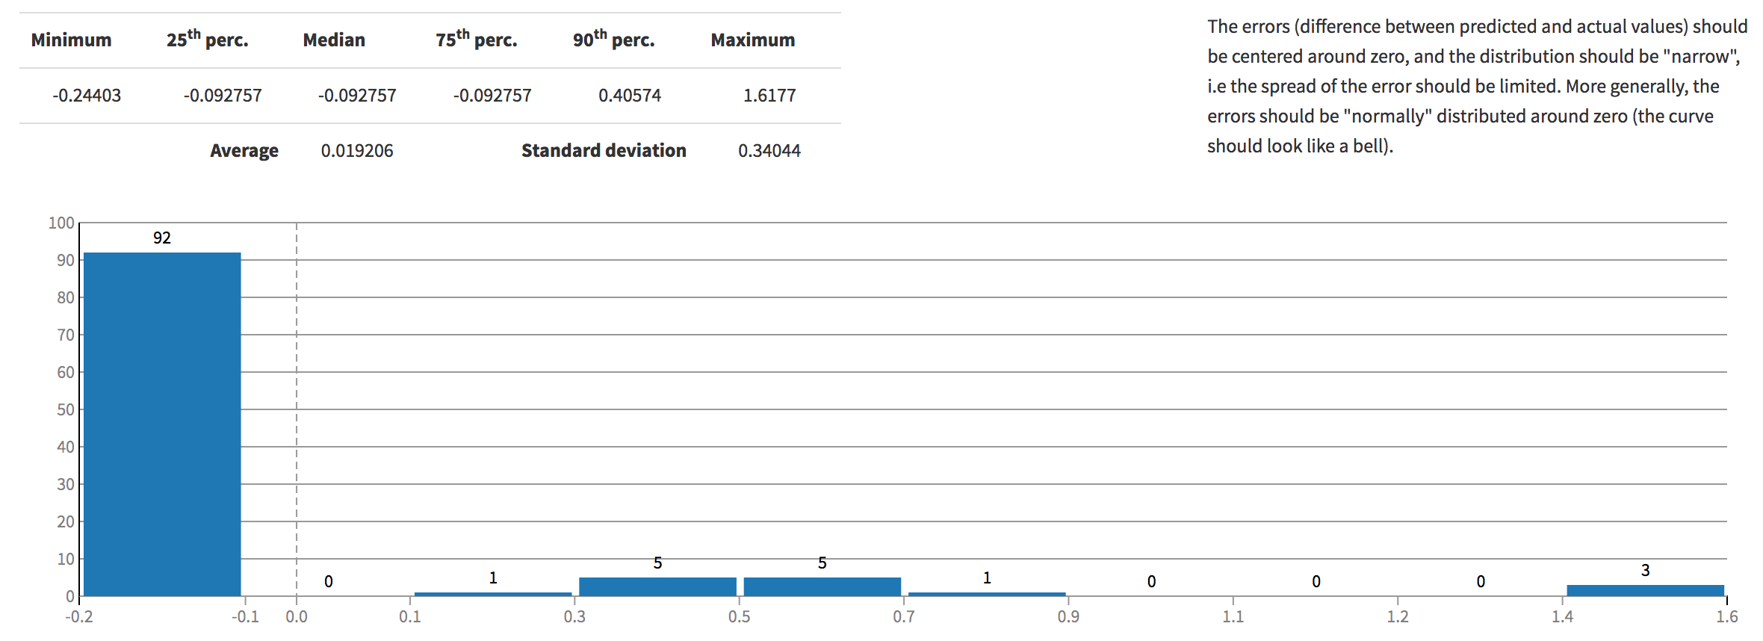
REPEAT PURCHASES: LASSO ERROR DISTRIBUTION

Slide 22
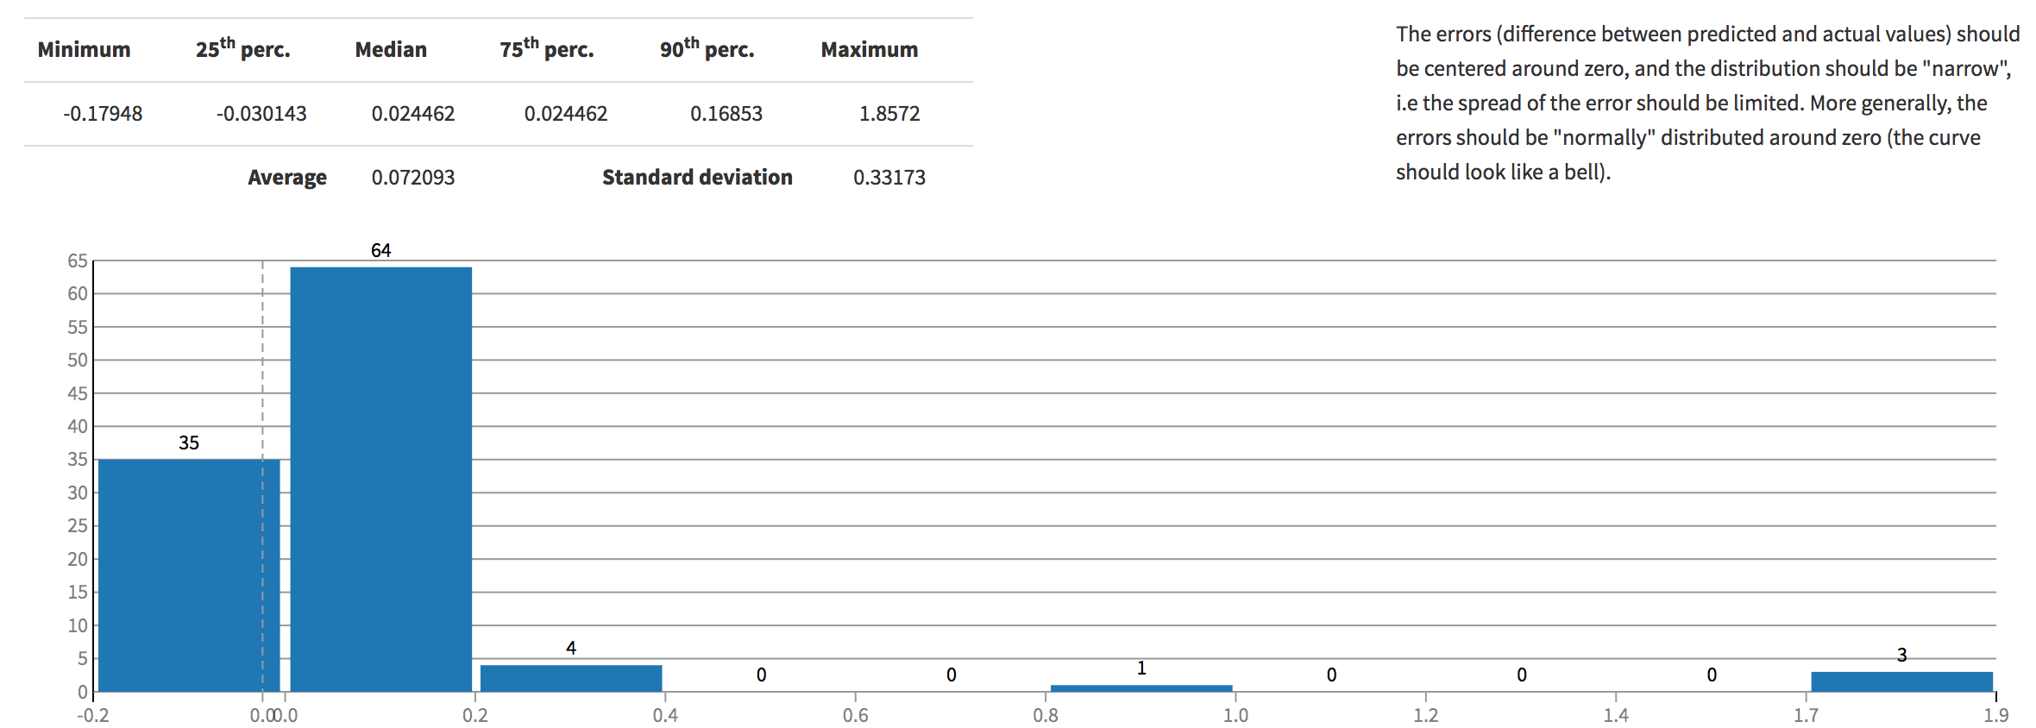
REPEAT PURCHASES: XGBOOST ERROR DISTRIBUTION

Slide 23
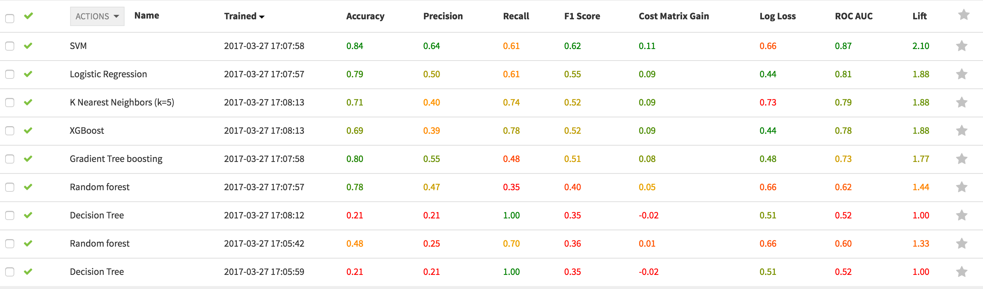
GENDER: MODEL OUTPUT

Slide 24
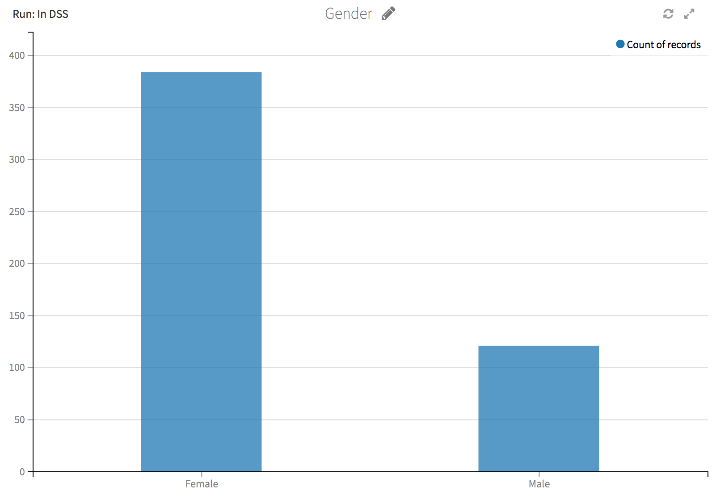
GENDER

Slide 25
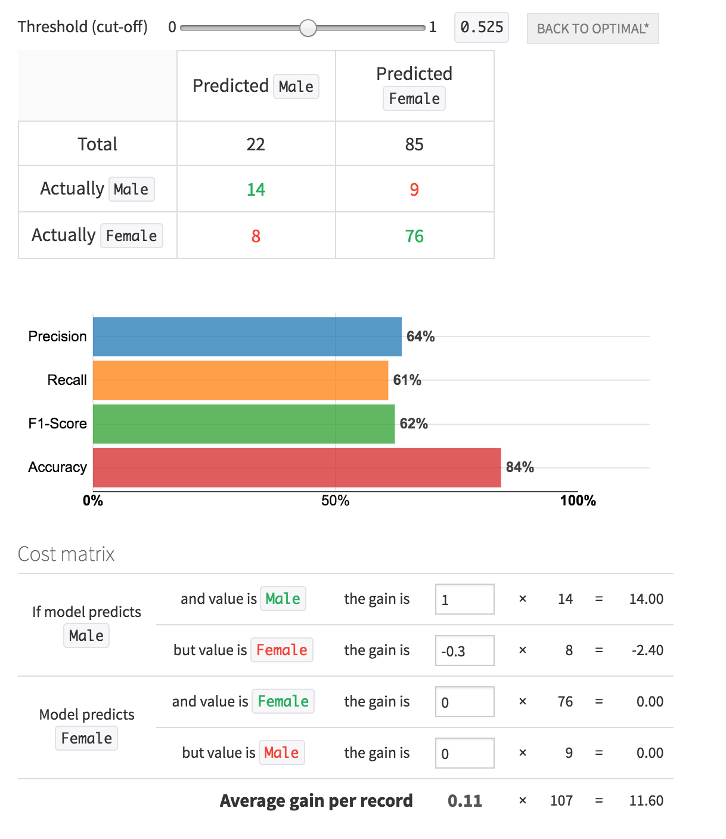
GENDER: SVM CONFUSION MATRIX & ACCURACY

Slide 26
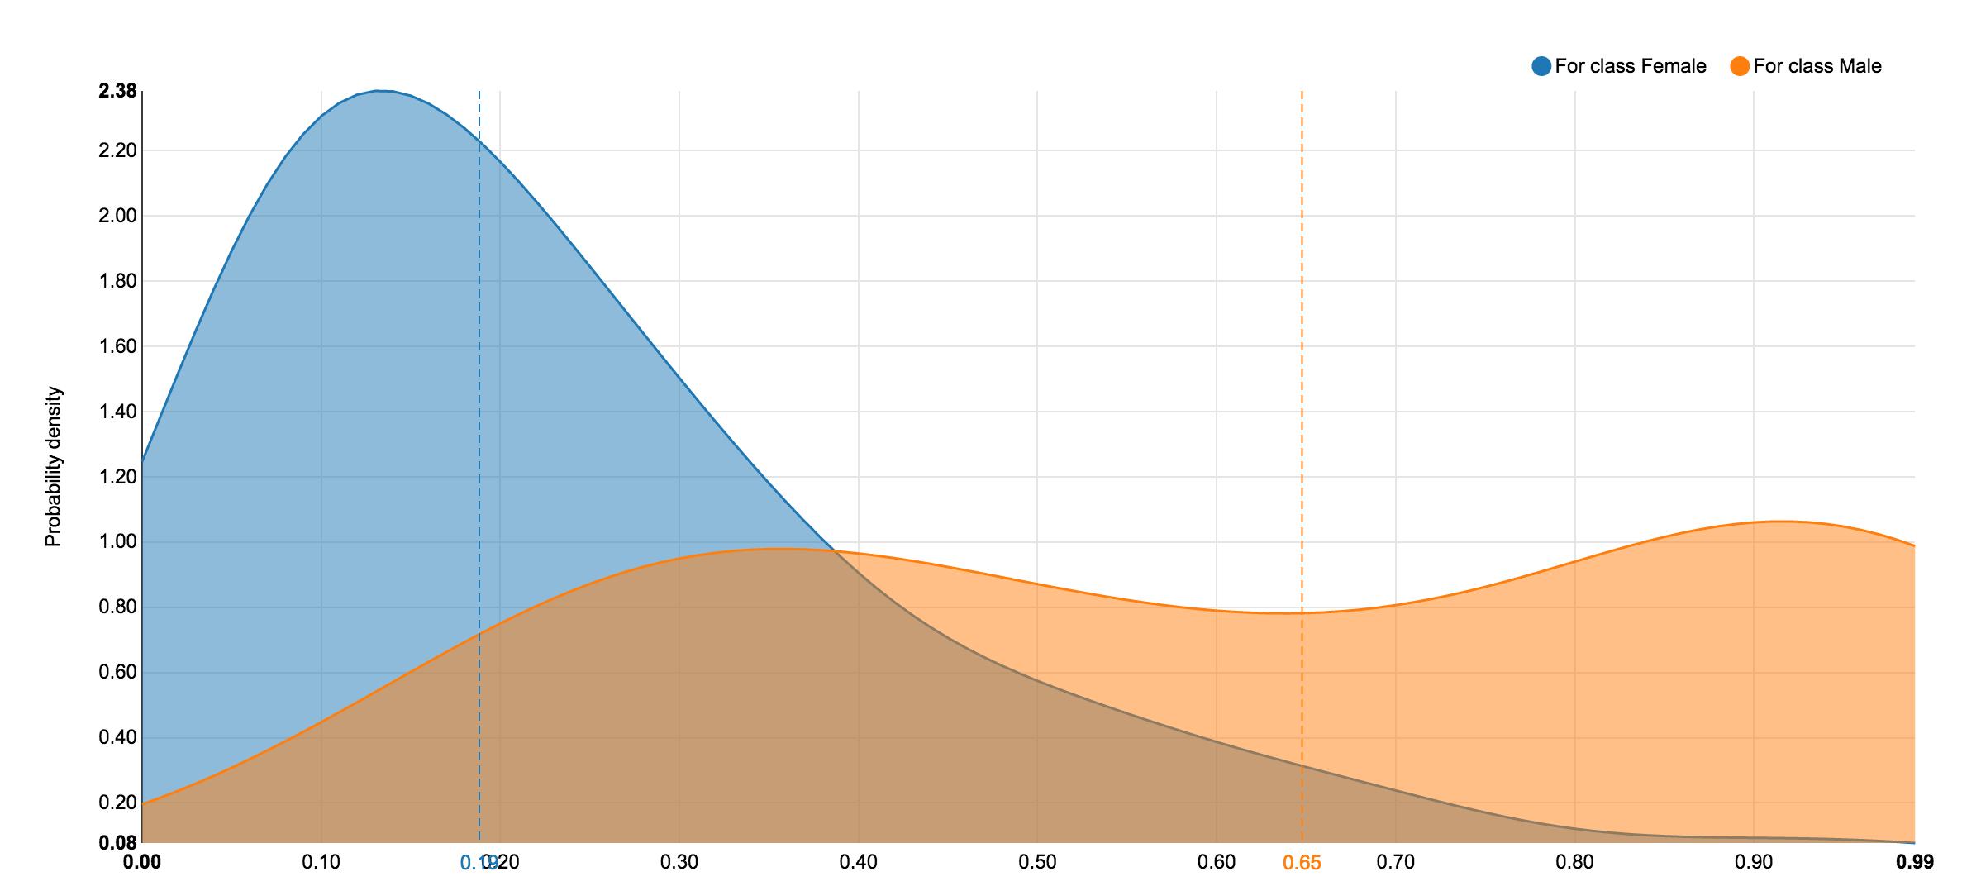
GENDER: SVM DENSITY CURVE

Slide 27
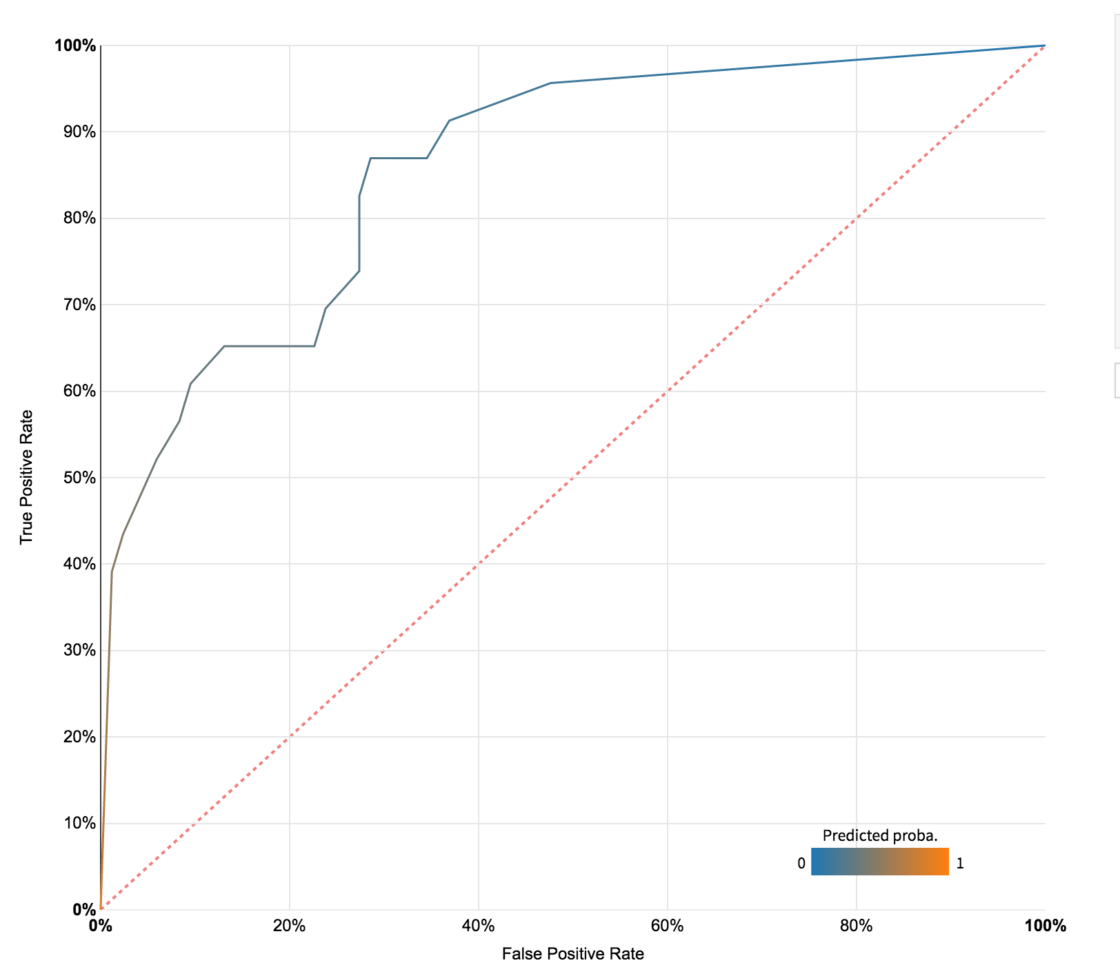
GENDER: SVM ROC AUC CURVE

Slide 28
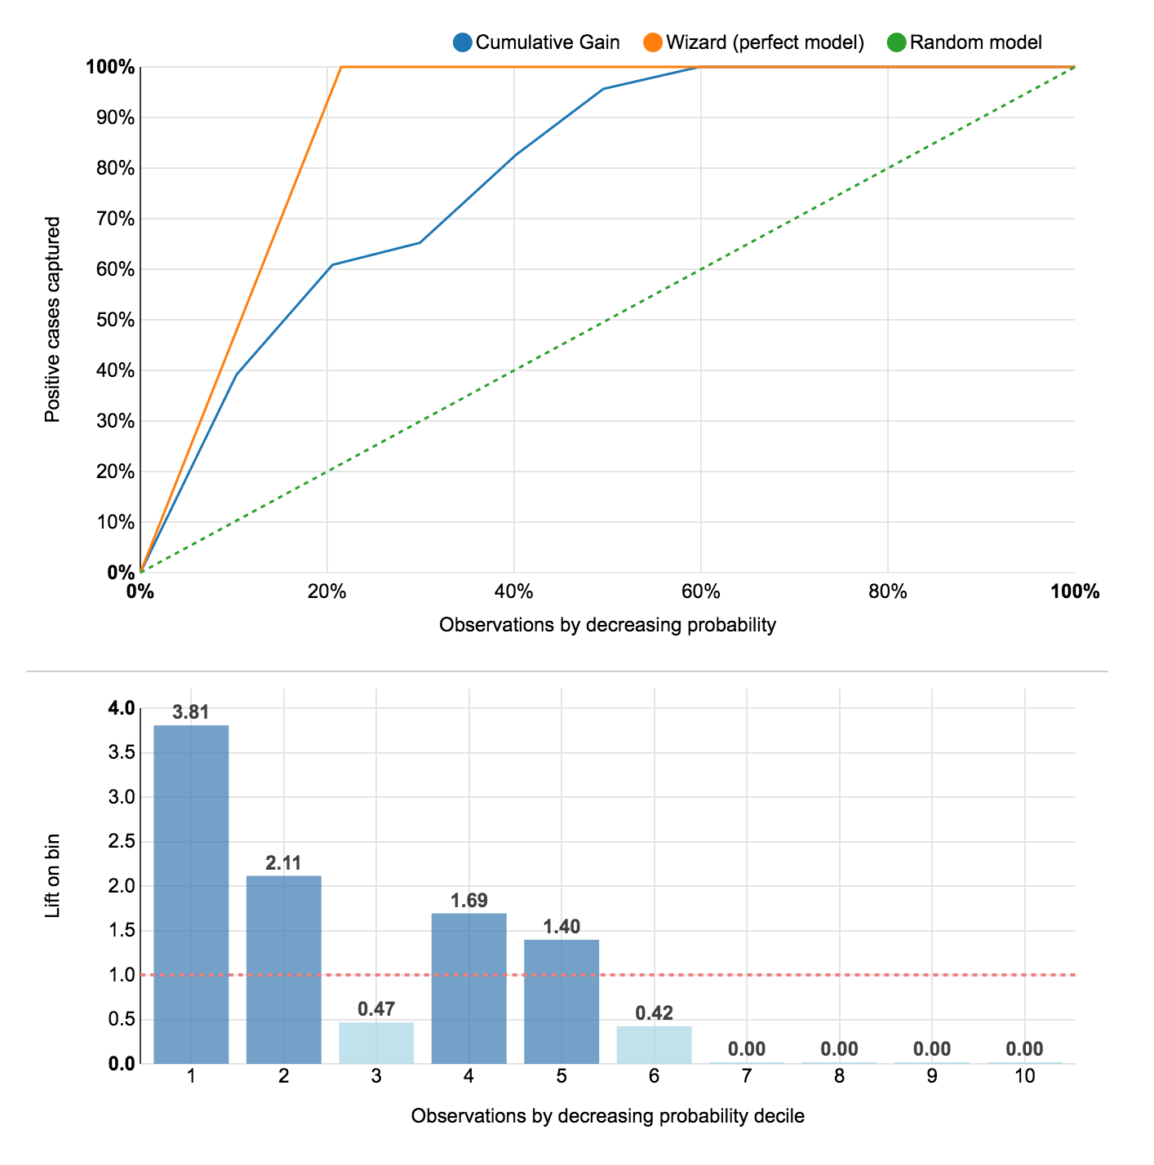
GENDER: SVM LIFT CHARTS

Slide 29
BUSINESS RECOMENDATIONS
Web traffic and sales conversions coming from New England and Eastern US
Focus traffic driving tactics to grow ‘sweet spot’
Target marketing for gender
Grow other ‘bee’ regions
Make 1x purchasers repeat-purchasers
Constant contact CRM solution using email promotion
Investment in search engine marketing

